Slide 1
ECG Basics
Dr. Vaibhav Kapare
Dept. Of Cardiovascular & Respiratory Physiotherapy MGM Institute Of Physiotherapy Chh. Sambhajinagar

Slide 2
Outline
Review of the conduction system
ECG waveforms and intervals
ECG leads
Determining heart rate
Determining QRS axis

Slide 3
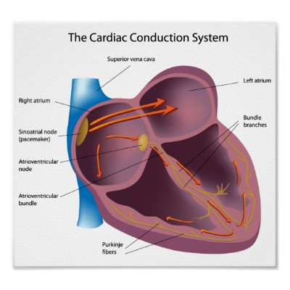
CARDIAC CONDUCTION SYSTEM
SA NODE :
-AT THE UPPER POSTERIOR PART OF THE ATRIUM
-PRIMARY PACEMAKER
-DISCHARGES ELECTICAL IMPULSES 60-100 A MINUTE
AV NODE :
-RECEIVES IMPULSES FROM SA NODE
-SLOW THE CONDUCTION AND DELAYS THE
INPUT SO THAT THE VENTRICLES CAN FILL COMPLETELY BEFORE CONTRACTION.
-BLOCK SOME OF THE IMPULSES TO PREVENT GOING THE HEART TACHY
-SERVES AS A BACK UP PACEMAKER IF SA NODE
FAILS (ELECTRICAL IMPULSES OF 40-60 A MINUTE)
PURKINJE FIBERS:
-RECEIVES IMPULSES FROM BUNDLE
BRANCHES
-DISCHARGES ELECTRICAL IMPULSES 20-40
A MINUTE

Slide 4
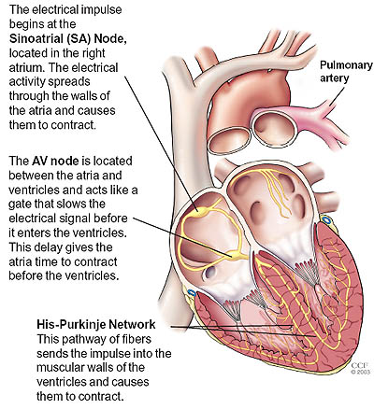

Slide 5
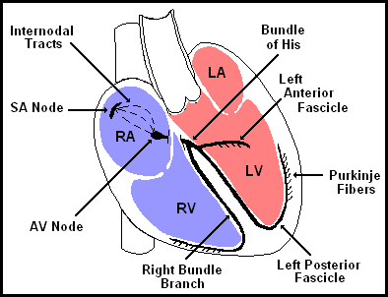
The Normal Conduction System

Slide 6
What is an ECG?
The electrocardiogram (ECG) is a representation of the electrical events of the cardiac cycle.
An electrocardiogram — abbreviated as EKG or ECG — is a test that measures the electrical activity of the heartbeat. With each beat, an electrical impulse (or “wave”) travels through the heart. This wave causes the muscle to squeeze and pump blood from the heart.
Each event has a distinctive waveform, the study of which can lead to greater insight into a patient’s cardiac pathophysiology.

Slide 7
Basic ECG waves
P wave : atria depolarization
QRS complex : ventricular depolarization
ST segment, T wave, U wave: ventricular repolarization

Slide 8
Atrial T wave: 0.15 – 0.20 secs after atrial depolarization
Overlaps vent depolarization hence not recorded

Slide 9
ECG Paper
speed of the paper is 25 mm/sec

Slide 10
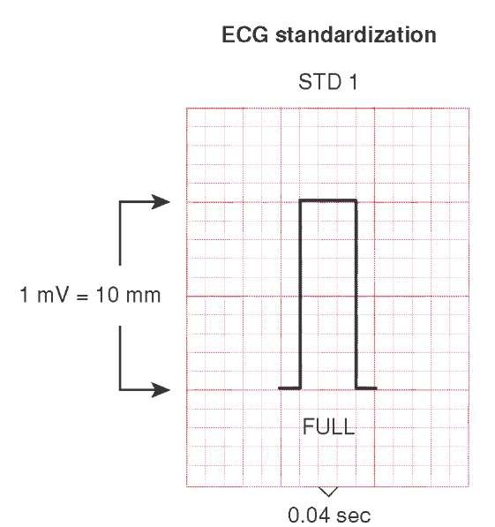
Normal values
Standardization:
1mv signal produces
10mm deflection
Standardization mark

Slide 11
P wave: amplitude less than or equal to 2.5 mm
PR interval: 0.12 – 0.2 sec
QRS complex : 8 mm, 0.1sec

Slide 12
QRS Interval
Not every QRS complex will contain a Q wave, a R wave and a S wave
1st negative deflection: Q wave
1st positive deflection: R wave
Negative deflection following R wave: S wave

Slide 13
P wave: amplitude less than or equal to 2.5 mm
PR interval: 0.12 – 0.2 sec
QRS complex : 8 mm, 0.1sec

Slide 15
R
R
r
q
Q
Q
R
R
q
QS
S

Slide 16
Sometimes QRS complex may have more than 2 or 3 deflections. The extra waves are called R’ if positive and S’ if negative

Slide 17
R
r
r
S
S

Slide 18
ST segment: represents beginning of ventricular repolarization
Normal ST segment is isoelectric
May be slightly elevated/depressed (< 1 mm)
ST
J point

Slide 19
T wave: ventricular repolarization, 3.5mm
Asymmetric shape
Peak closer to the end of the wave

Slide 20
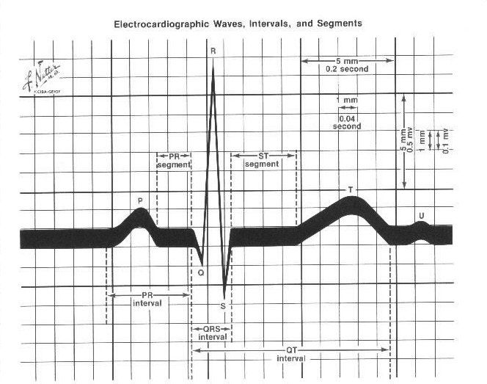

Slide 21
Calculation of HR
a. Count the number of large boxes between 2 R waves and divide this number into 300

Slide 22
1 2 3 4 5 6 7
Notes:
300 / 7 = 43

Slide 23
b. Obtain a six second tracing (30, five mm boxes) and count the number of R waves and multiply by 10 to obtain the HR/min

Slide 24
1 2 3 4 5 6 7 8 9 10 11 12 13 14 15 16 17 18 19 20 21 22 23 24 25 26 27 28 29 30
Notes:
4 x 10 = 40 bpm

Slide 25
c. 10 Second Rule
As most ECGs record 10 seconds of rhythm per page, one can simply count the number of beats present on the EKG and multiply by 6 to get the number of beats per 60 seconds.
This method works well for irregular rhythms.

Slide 26
What is the heart rate?
The Alan E. Lindsay ECG Learning Center ; http://medstat.med.utah.edu/kw/ecg/
33 x 6 = 198 bpm

Slide 27
The Rule of 300
It may be easiest to memorize the following table:
# of big boxes | Rate
1 | 300
2 | 150
3 | 100
4 | 75
5 | 60
6 | 50

Slide 28
What types of pathology can we identify and study from ECGs?
Arrhythmias
Myocardial ischemia and infarction
Pericarditis
Chamber hypertrophy
Electrolyte disturbances (i.e. hyperkalemia, hypokalemia)
Drug toxicity (i.e. digoxin and drugs which prolong the QT interval)

Slide 29
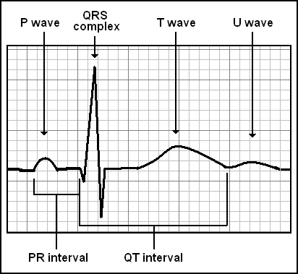
Waveforms and Intervals

Slide 30
ECG Leads
Leads are electrodes which measure the difference in electrical potential between either:
1. Two different points on the body (bipolar leads)
2. One point on the body and a virtual reference point with zero electrical potential, located in the center of the heart (unipolar leads)

Slide 31
ECG Leads
The standard ECG has 12 leads:
3 Standard Limb Leads
3 Augmented Limb Leads
6 Precordial Leads
The axis of a particular lead represents the viewpoint from which it looks at the heart.

Slide 32
Limb leads Unipolar
Bipolar
Bipolar leads
Lead I : records difference of potential between LA and RA
Lead I = LA - RA
Lead II :records difference of potential between LL and RA
Lead II = LL - RA

Slide 33
Lead III : records difference of potential between LL and LA
Lead III = LL - LA

Slide 34
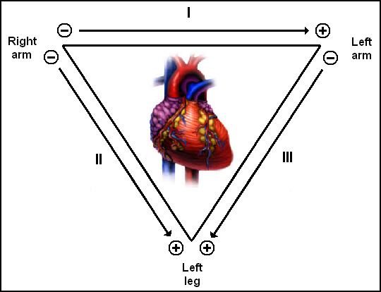
Standard Limb Leads

Slide 36
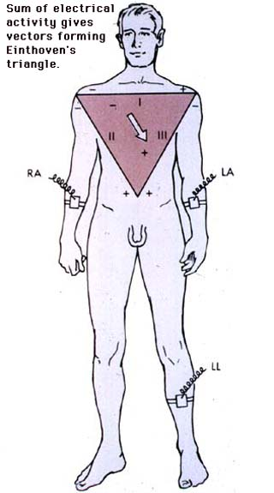

Slide 37
Einthoven law
According to this law, in a ectrocardiogram the potential of any wave or complex in lead II is equal to the sum of its potentials in leads I and III.

Slide 38
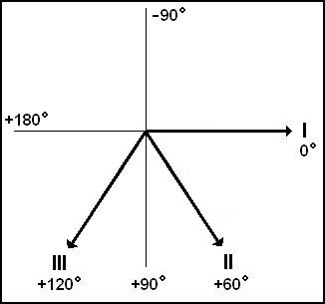
Standard Limb Leads

Slide 39
Augmented Limb Leads
The same three leads that form the standard leads also form the three unipolar leads known as the augmented leads. These three leads are referred to as aVR (right arm), aVL (left arm) and aVF (left leg) and also record a change in electric potential in the frontal plane.
These leads are unipolar in that they measure the electric potential at one point with respect to a null point (one which doesn't register any significant variation in electric potential during contraction of the heart).

Slide 40
This null point is obtained for each lead by adding the potential from the other two leads. For example, in lead aVR, the electric potential of the right arm is compared to a null point which is obtained by adding together the potential of lead aVL and lead aVF.

Slide 41
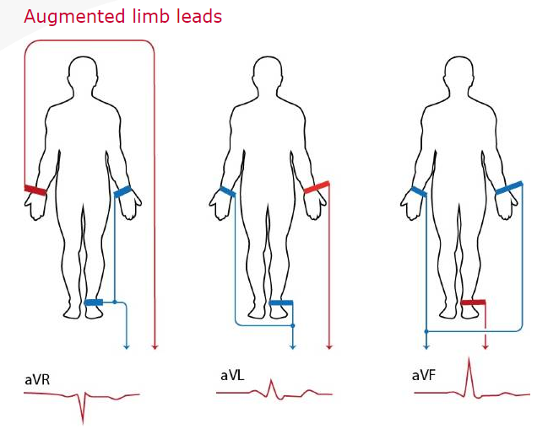

Slide 42
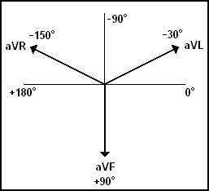
Augmented Limb Leads

Slide 43
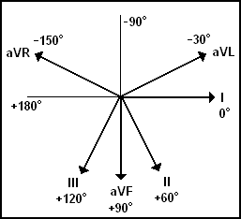
All Limb Leads

Slide 44
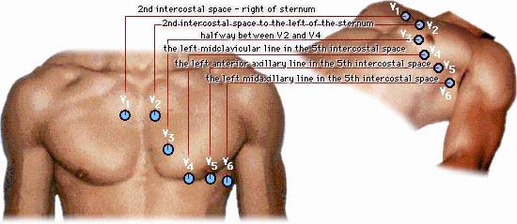
Chest leads

Slide 45
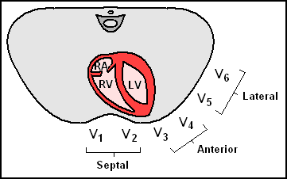
Precordial Leads

Slide 46
Summary of Leads
 | Limb Leads | Precordial Leads
Bipolar | I, II, III (standard limb leads) | -
Unipolar | aVR, aVL, aVF (augmented limb leads) | V₁-V₆

Slide 47
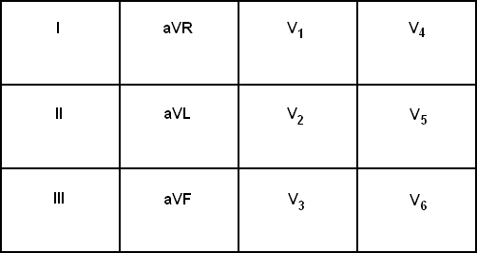
Arrangement of Leads on the ECG

Slide 48
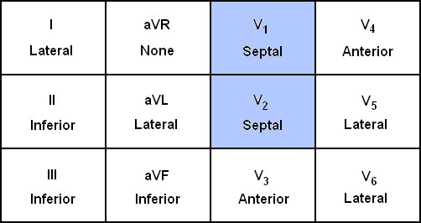
Anatomic Groups (Septum)

Slide 49
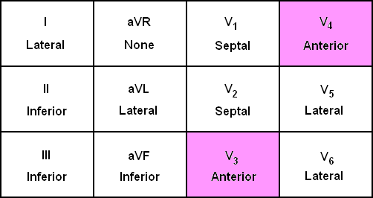
Anatomic Groups (Anterior Wall)

Slide 50
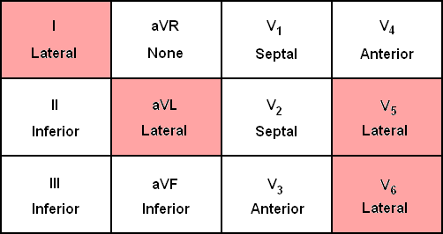
Anatomic Groups (Lateral Wall)

Slide 51
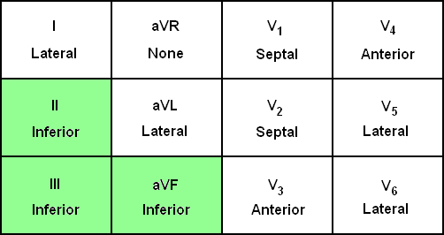
Anatomic Groups (Inferior Wall)

Slide 52
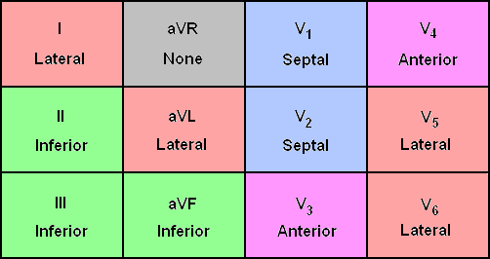
Anatomic Groups (Summary)

Slide 53
The QRS Axis
The QRS axis represents the net overall direction of the heart’s electrical activity.
Abnormalities of axis can hint at:
Ventricular enlargement
Conduction blocks (i.e. hemiblocks)

Slide 54
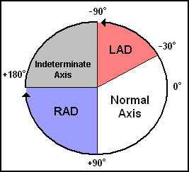
The QRS Axis
By near-consensus, the normal QRS axis is defined as ranging from -30° to +90°.
-30° to -90° is referred to as a left axis deviation (LAD)
+90° to +180° is referred to as a right axis deviation (RAD)

Slide 55
Determining the Axis
The Quadrant Approach
The Equiphasic Approach

Slide 59
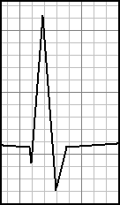
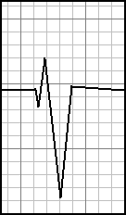
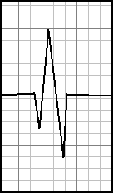
Determining the Axis
Predominantly Positive
Predominantly Negative
Equiphasic

Slide 60
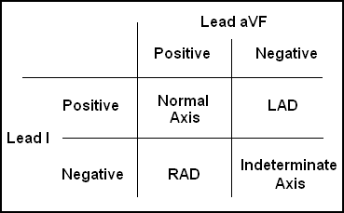
The Quadrant Approach
1. Examine the QRS complex in leads I and aVF to determine if they are predominantly positive or predominantly negative. The combination should place the axis into one of the 4 quadrants below.

Slide 61
The Quadrant Approach
2. In the event that LAD is present, examine lead II to determine if this deviation is pathologic. If the QRS in II is predominantly positive, the LAD is non-pathologic (in other words, the axis is normal). If it is predominantly negative, it is pathologic.

Slide 62
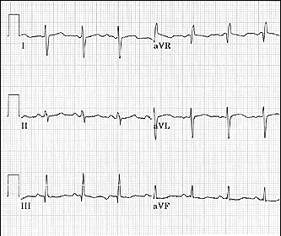
Quadrant Approach: Example 1
The Alan E. Lindsay ECG Learning Center http://medstat.med.utah.edu/kw/ecg/
Negative in I, positive in aVF → RAD

Slide 63
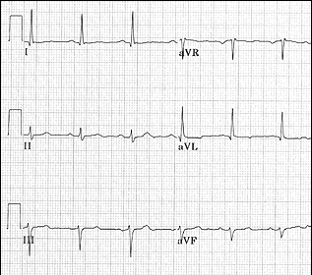
Quadrant Approach: Example 2
The Alan E. Lindsay ECG Learning Center http://medstat.med.utah.edu/kw/ecg/
Positive in I, negative in aVF → Predominantly positive in II →
Normal Axis (non-pathologic LAD)

Slide 64
The Equiphasic Approach
1. Determine which lead contains the most equiphasic QRS complex. The fact that the QRS complex in this lead is equally positive and negative indicates that the net electrical vector (i.e. overall QRS axis) is perpendicular to the axis of this particular lead.
2. Examine the QRS complex in whichever lead lies 90° away from the lead identified in step 1. If the QRS complex in this second lead is predominantly positive, than the axis of this lead is approximately the same as the net QRS axis. If the QRS complex is predominantly negative, than the net QRS axis lies 180° from the axis of this lead.

Slide 65
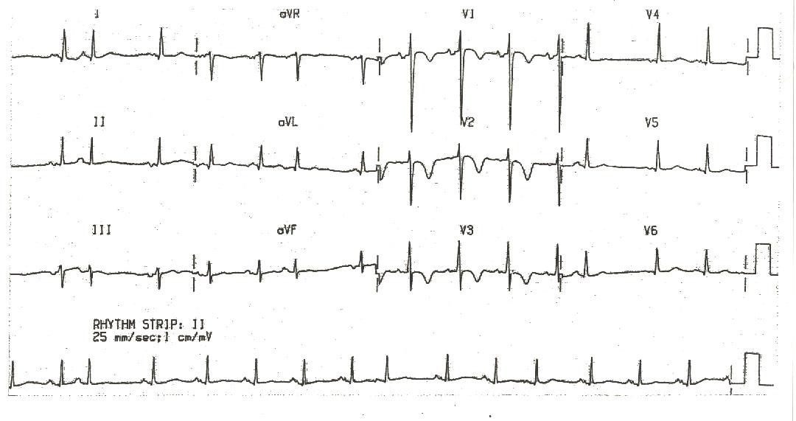
Equiphasic Approach: Example 1
The Alan E. Lindsay ECG Learning Center ; http://medstat.med.utah.edu/kw/ecg/
Equiphasic in aVF → Predominantly positive in I → QRS axis ≈ 0°

Slide 66
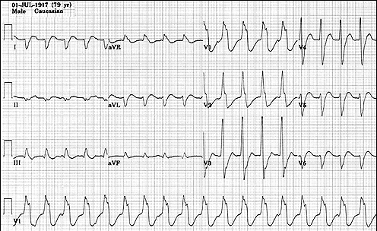
Equiphasic Approach: Example 2
The Alan E. Lindsay ECG Learning Center ; http://medstat.med.utah.edu/kw/ecg/
Equiphasic in II → Predominantly negative in aVL → QRS axis ≈ +150°

Slide 67
Myocardial Ischemia & Infarction
Transmural & subendocardial ischemia
subendocardial
Transmural

Slide 68
Transmural MI
Changes in ST-T segment
2 phases
Acute phase
Evolving phase

Slide 69
Acute Phase
ST elevations
Hyperacute T waves

Slide 70
Evolving Phase: hours to days later
ST segments return to baseline
Inverted T waves in leads which showed ST elevation

Slide 71
QRS changes: Q wave of infarction
Necrosis of myocardium
Disappearance of electrical voltages
Q wave instead of R wave is recorded

Slide 72
Reciprocity of ST-T changes
Anterior and Inferior leads show inverse patterns
In anterior MI: ST elevations seen in V1 – V6 and aVl
ST depressions seen in lead II, III, aVf

Slide 73
Inferior wall MI : ST elevation in lead II, III and aVf
ST depression in V1-V6, aVl and I

Slide 75
Localization of Infarcts
Anterior wall infarction
Loss of R wave progression
Anteroseptal infarcts: V1-V2
Anterior: V3-V4
Anterolateral: V5-V6

Slide 76
Inferior wall infarcts: lead II, III, aVf
Posterior infarctions:
Tall R waves & ST depressions in V1 , V2
Tall T waves in anterior chest leads

Slide 77
What is the heart rate?
www.uptodate.com
Notes:
(300 / 6) = 50 bpm

Slide 78
What is the heart rate?
www.uptodate.com
Notes:
(300 / ~ 4) = ~ 75 bpm

Slide 79
What is the heart rate?
Notes:
(300 / 1.5) = 200 bpm

